Slide 1

What do you do with all of this data?
Using the Community College Survey of Student Engagement (CCSSE) for Institutional Improvement:
One College’s Approach to Using the Data for Decision Making
Presented By: Debbie Hardy

Slide 2
Objectives
Share tips for identifying data gaps
Discuss how to establish institutional priorities
Discuss how high impact practices increases student success
Share tips for creating an action plan for improvement
Use the survey as a tool for institutional improvement

Slide 3
CCSSE
CCSSE provides information on student engagement, a key indicator of learning
Questions assess institutional practices and student behaviors correlated with student learning and student retention
Used as a tool for improvement
Self-reported by students

Slide 4
CCSSE
Benchmark Comparisons- related survey items that address key areas of student engagement (three-year cohort includes 2012, 2013, 2014)
Frequencies-individual questions within survey
Core Survey Items- kept consistent in all surveys
Special Focus Items- examines areas of student experience and institutional performance that are of particular interest

Slide 5
Communicating Results-Share the Data
Have Conversations
Table Top Discussions
Data Carousel
Share Fairs (Great Teachers Workshop)
Newsletters
Work Teams
Web Page

Slide 6
Data Carousel Activity (example)
Share two or three samples of data such as charts/graphs at each table-(each table only has one set of data)
  Directions: Spend a few minutes thinking individually about the data provided. Answer each question using a post-it (3-5 minutes)
WHAT…questions does the data raise for you? (pink post-it)
WHAT…surprised you about the data? (yellow post-it)
WHAT…can I do to improve the data in this area?(orange post-it)
Post your color coded response on the poster sheet on the wall next to the appropriate question.
Discuss as a group.

Slide 7
Why this is important…
Allows you to look at policies and procedures to determine inconsistencies
Identifies what is and is not working
Allows you to understand strengths and weaknesses
  Gaps in gender and ethnicity
  Gaps in services provided
Allows you to improve areas of teaching and learning
Allows you to decide the professional development needed
Allows you to set goals or adjust goals to develop specific strategies for improvement

Slide 8
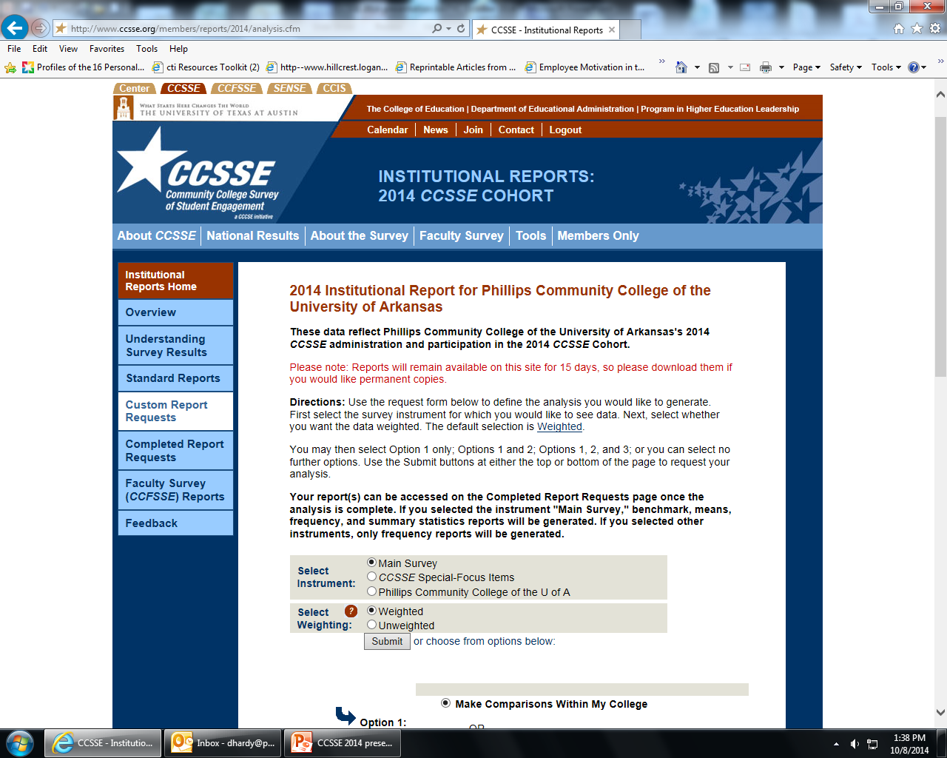

Slide 9
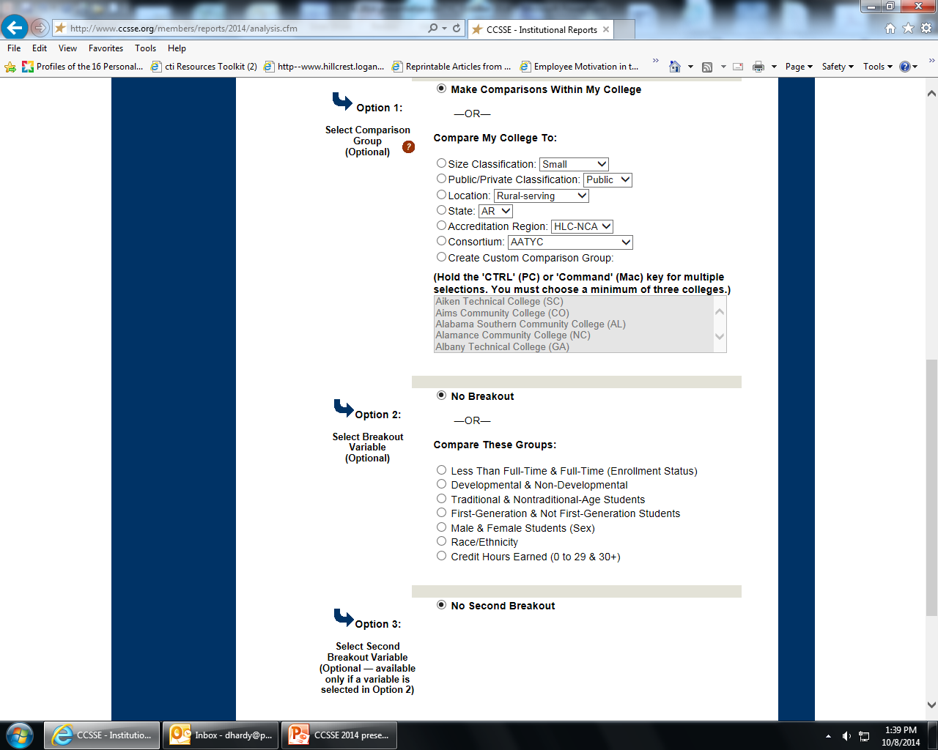
Disaggregate data

Slide 10
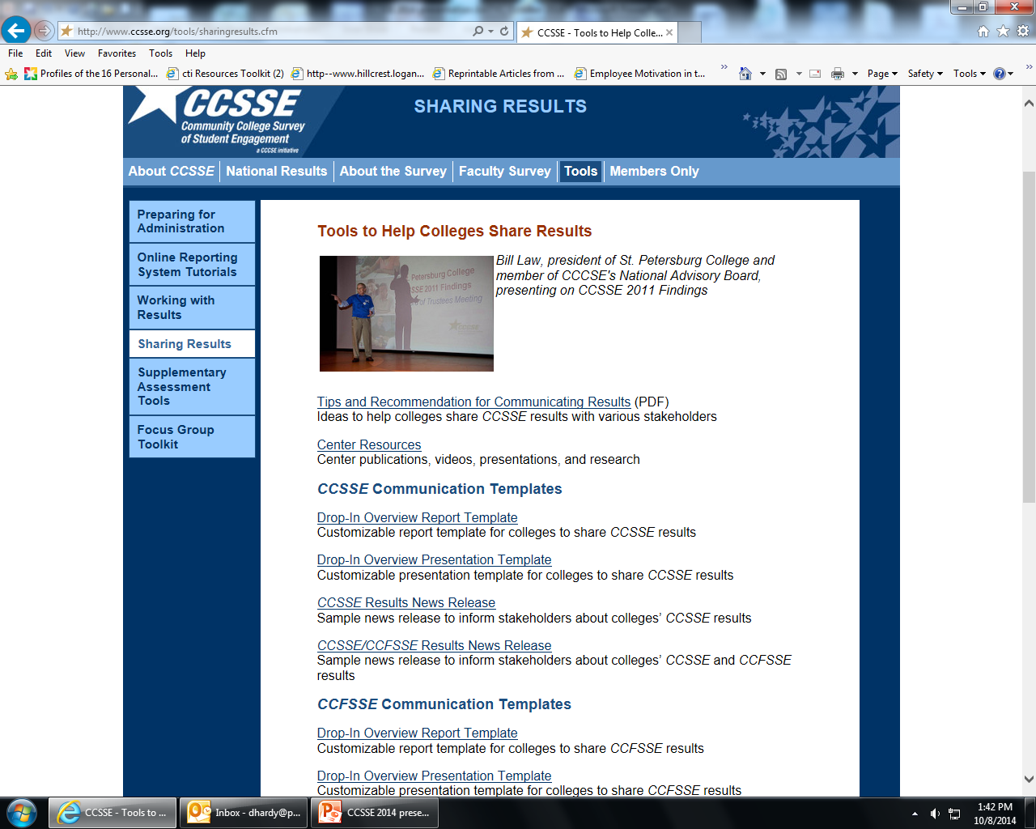
Use Tools CCSSE provides

Slide 11
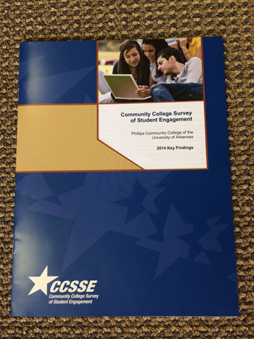
PCCUA 2014 Key Findings
Promising Practices for Student Success
Benchmark Overview by Enrollment
Benchmarks of Effective Educational Practice
Aspects of Highest Student Engagement
Aspects of Lowest Student Engagement
Special-Focus Items
CCFSSE- Faculty Survey

Slide 12
*Top Performing colleges are those that scored in the top 10 percent of the cohort by benchmark.
2014 CCSSE Key Findings

Slide 13
Reaching for Excellence
Target improvement efforts by disaggregating results to look at different groups – male & female, developmental & non-developmental etc.
Multiple administrations- look at impact of interventions over time and measure institutional effectiveness

Slide 14
Disaggregated Data
CCSSE 2014 Data

Slide 15
Disaggregated Data- Gender and Ethnicity
CCSSE 2014 Data

Slide 16
Benchmark Comparison 2012 and 2014
CCSSE 2012 and 2014 Data

Slide 17
CCFSSE
Community College Faculty Survey of Student Engagement
Companion Survey to CCSSE
  Information from faculty about their teaching practices
  The way they spend their professional time, both in and out of class
  Perceptions regarding students’ education experiences
Full-time and Part-time Faculty

Slide 18
CCSSE and CCFSSE-Student Effort
Responded Very Often or Often; Quite a bit or Very Much
2014 CCSSE and CCFSSE Data

Slide 19
CCSSE and CCFSSE- Active and Collaborative Learning
Responded Very Often or Often; Quite a bit or Very Much
2014 CCSSE and CCFSSE Data

Slide 20
Using CCSSE for Institutional Improvement
Identify key areas
(Strategic Plan/Initiatives)
Identify survey items that address these priorities
Start with benchmarks
Look at individual survey items
Disaggregate the data and identify the least engaged student groups
Involve the college community
Design strategies and set targets
Share the data and plans to address them
Track progress by measuring outcomes
Scale up efforts that are working and modify those that are not

Slide 21
Practical Uses of CCSSE for Improvements-PCCUA
Student Success Pass
Mandatory Student Orientation
Professional Development- Student Engagement
(Great Teachers Workshop)
Professional Development-Cooperative Learning
African American Male Mentoring Group-META
(Men Enrolling Toward Advancement)
Strategic Planning
Conversations/Shared Data
Common Readers-Discussed poverty, gender and ethnicity

Slide 22
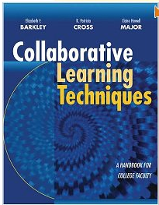
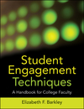
Tools for Faculty
Collaborative Learning Techniques
  Elizabeth Barkley, K. Patricia Cross, Claire Howell Major
Student Engagement Techniques
  Elizabeth F. Barkley

Slide 23
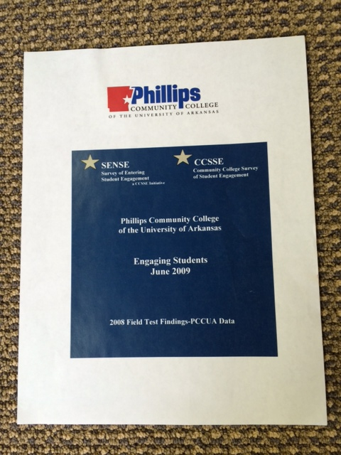
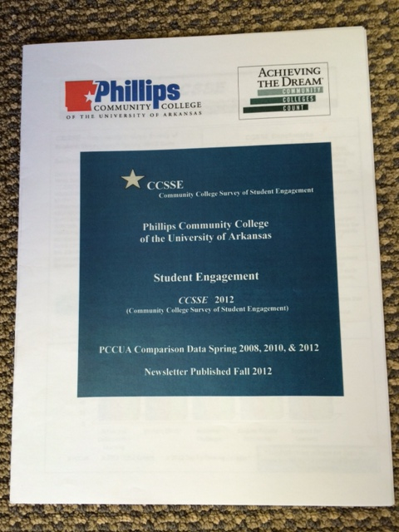
CCSSE/CCFSSE and SENSE Newsletters

Slide 24
Using Data for Improvement: ESSI Institute Training
Center for Community College Student Engagement hosted an Entering Student Success Institute (ESSI)
Institute was 2 ½ days
Participants reviewed institutional survey data from SENSE Survey
Team approach
Identified priorities and strategies to improve student success and retention
Developed action plan to initiate strategies
SENSE 2008 data-team of administrators
SENSE 2009 data-team of faculty

Slide 25
Entering Student Success Institute (ESSI)
ESSI 2009
  Administrative team established Action Plan with three priorities
    New student orientation
    Intrusive advising
    Align PCCUA policies, practices and initiatives to promote the student success agenda throughout the college
ESSI 2010
  Faculty team established Action Plan with three priorities
    Communication: Interactive Data Sharing-Faculty Engagement
    Reinforce Early Alert
    Classroom Student Engagement-Faculty Professional Development

Slide 26
2012 CCSSE Institute-PCCUA
Modeled the ESSI Institute and created a PCCUA Institute
The workshop was facilitated by Arleen Arnsparger, Project Manager for the Initiative on Student Success at the Center for Community College Student Engagement in Austin, Texas.
A team of faculty and staff worked together to review the data provided from the CCSSE and CCFSSE surveys conducted during the spring 2012 semester.
During the one and a half days, the team worked with the data, discussed strategies that could improve the student experience, and formulated an action plan for initiating appropriate strategies.

Slide 27
CCSSE Action Plan (Prioritized)
Redesign college strategic plan (review every three to four years)
Continue faculty development
Deepen understanding of collaborative learning
Set consistent ( applied the same way) and uniform (the same) norms for college practices
Provide more opportunities and sharing for adjunct faculty
Ensure that data provided for discussion and application is "real" and "useable" for faculty and staff
Make college data accessible to all
Use more focus groups and other one to one approaches to gather information

Slide 28
CCSSE and Strategic Planning
Redesigned the college strategic plan in 2012-13
Based on outcomes from the CCSSE Institute
Developed a dynamic plan driven by desire to see student success at the forefront of the work we do
Frequently revisit the plan for review and modification (Review September/April)
This plan is driven by three simple practices:
  Connect to our students
  Engage our students
  Engage in the lives of our students

Slide 29
Center for Community College Student Engagement Survey Tools
Survey of Entering Student Engagement (SENSE) Administered during the 4th and 5th weeks of the fall term Focuses on students’ experiences from the time they decide to attend through the end of the first three weeks of the term | Community College Survey of Student Engagement (CCSSE) Administered in the spring semester Gathers information from students about their overall experiences at the college
Community College Faculty Survey of Student Engagement (CCFSSE) Administered in conjunction with CCSSE to all faculty teaching credit courses Gathers information on instructors’ perceptions of student experiences and about teaching practices and use of professional time | Community College Institutional Survey (CCIS) Collects information on identifying and promoting high-impact educational practices in community colleges Gathers information about whether and how colleges implement a variety of promising practices

Slide 30
Four Surveys, Four Perspectives
All are tools that assess student behaviors and institutional practices that promote student engagement in meaningful education experiences.
Special Focus Items: examine areas that allows for deeper exploration into issues that are key to improved student engagement and success.
Special focus items for the 2011, 2012 and 2013 surveys address promising practices for promoting student success and completion.

Slide 31
High Impact Practices Institute
Cohort Data Review
    Institutional Data-Course completion, course persistence, term to term, and earning no credit
    Disaggregated by enrollment, gender, race/ethnicity and age group
    CCSSE, CCFSSE, CCIS, SENSE
Integrating Survey Results
Short-Term Action Plan

Slide 32
Integrating Survey Results- 13 Educational Practices
Placement Test, Preparation, & Proper Placement
Orientation
Academic Goal Setting and Planning
Timely Registration
Accelerated/Fast Track Developmental Education
First-Year Experience
Student Success Course
Class Attendance
Learning Community
Academic Alert and Intervention System
Experiential Learning Beyond the Classroom
Tutoring
Supplemental Instruction

Slide 33
Develop Short-Term Action Plan
Key Findings-first impressions from the data
Identify potential priorities that fits the student success/college completion agenda
Design Principles-what do you want to act on
Build Promising Practices
Coherent Pathways and Action Planning

Slide 34
High Impact Practices- Action Plan
Priority/Strategy
  Early Intervention with Strong Support
    Tutoring
    Expand Student Success Coaching
    Individual Career Plan (ICP)
    Early Assessment and Faculty Interventions

Slide 35
Student Success Strategies
CCSSE data incorporated in all other college initiatives ATD, HLC Quality Improvement Project, High Impact Practices, WFSN, etc.
Next Steps: Continue to align all initiatives and focus on strategies (2014-15)
  Tutoring
  Expand Student Success Coach Role
  Career Planning
  Expand Financial Coaching
  Individual Career Plans (ICP)
  Early Interventions for Student Success
  Professional Development
Focus on practices that help students create a pathway to success

Slide 36


Slide 37


Slide 38
Data Sources Driving Strategies
CCSSE, CCFSSE and SENSE Data
ATD Data
Institutional Data
Student Success Data
Student Success Course Survey Data
Orientation Qualitative Survey Data
STAR Center Usage Data
Other

Slide 39
How can you use CCSSE at your college?
Review data
Select key data points
Communicate results
Conversations-engage
Honest data discussions
Make informed decisions based on data
Implement strategies to improve student success

Slide 40
Questions…

Slide 41

Debbie Hardy
Director of Student Success and Institutional Effectiveness
Phillips Community College
of the University of Arkansas
Helena, AR 72342
870-338-6474, ext.1242
dhardy@pccua.edu
PCCUA Web Sources:
www.pccua.edu/student_engagement
http://www.pccua.edu/Achieving%20the%20dream/

